Slide 1


Driving License &
Services

Slide 2
Presented By:
Name: Manav Mehta
Branch: C.E. Roll No: 11
Div: D1
Enroll. No.: 22002170110074
Name: Ansh Patel
Branch: C.E. Roll No: 12
Div: D1
Enroll. No.: 22002170110104
Name: Shivang Kosty
Branch: C.E. Roll No: 14
Div: D1
Enroll. No.: 22002170110059
Name: Dhrumil Trada
Branch: C.E. Roll No: 25
Div: D1
Enroll. No.: 22002170110194
Name: Jay Patel
Branch: I.T. Roll No: 26
Div: D1
Enroll. No.: 22002170210070

Slide 3
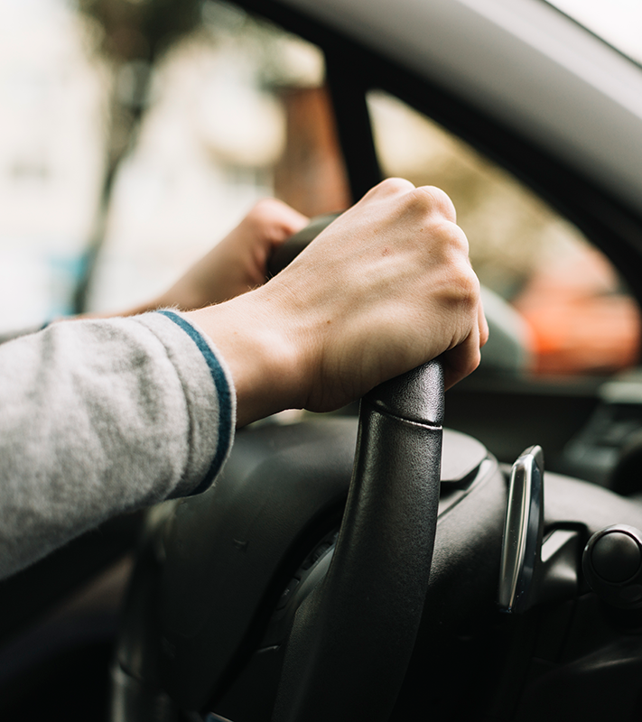
Introduction
Objective: To simplify the process of obtaining driving licenses, vehicle registration, and paying fines
Importance: Enhancing user experience and accessibility while reducing bureaucratic hurdles.
Focus: Simplify India's RTO interactions with a prototype for future convenience.

Slide 4
Table of Contents
01
02
03
Functionalities
Merits & Demerits
Future Scope & Conclusion

Slide 5
Functionalities
Learning License: Issue learning licenses.
Driving License: Generate driving licenses.
Vehicle Registration: Register new vehicles.
Check E-Challan: Verify and pay traffic fines.

Slide 6
Merits
Demerits
User Inputs are validated for expected formats/values.
Code handles file operations for generating and storing licenses.
Connects to a database for vital data storage and retrieval.
Multiple database connections in methods can be inefficient; opt for a connection pool for better performance.
Console interface is versatile, but web/mobile UI expands accessibility.

Slide 7
Future Scope & Conclusion
Integration with Online Payment Gateways for Fine Payment.
Mobile App Development for Greater User Accessibility.
"Driving License and Services" simplifies RTO interactions.
Promotes efficiency, accessibility, and future expansion potential.

Slide 8
THANK YOU!

